Slide 1


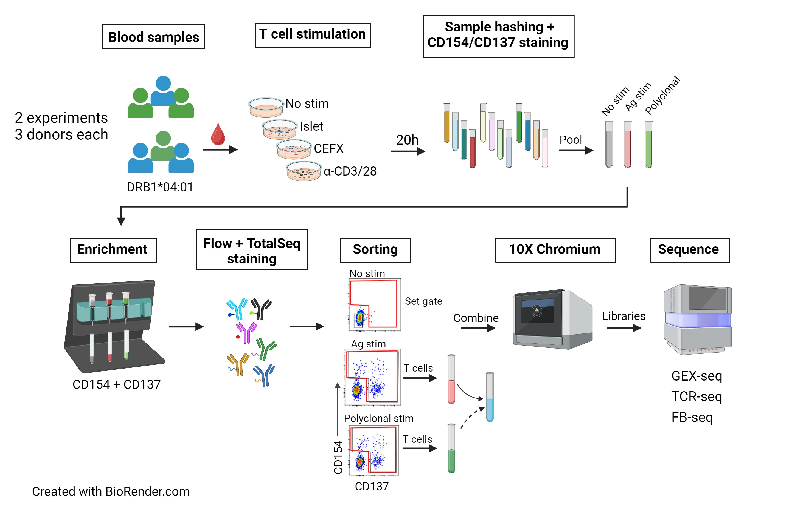
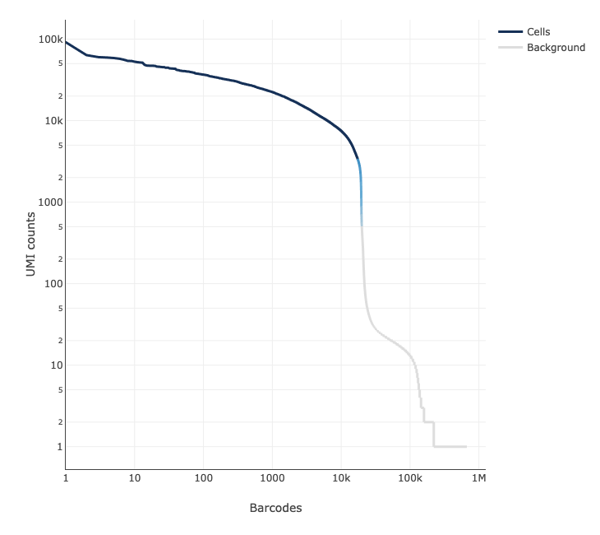
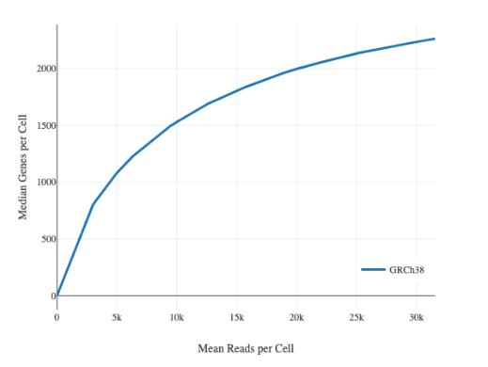
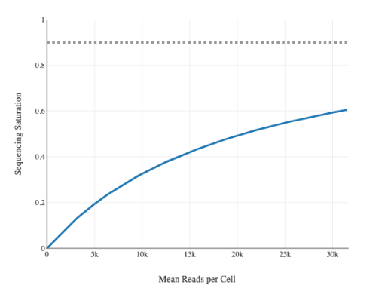
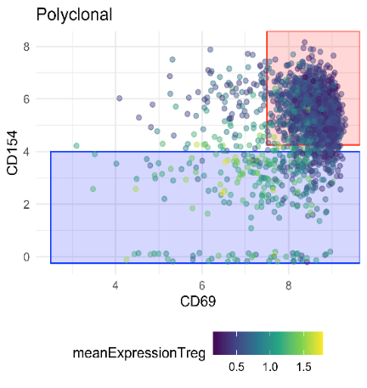
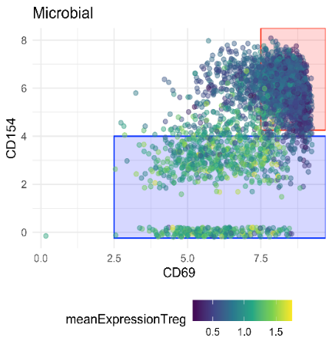
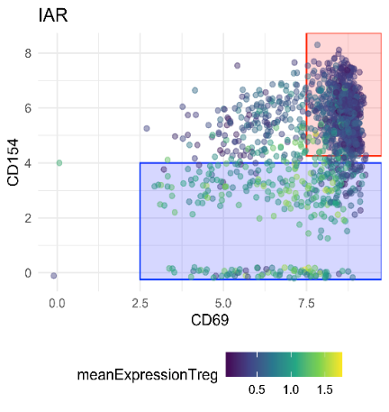
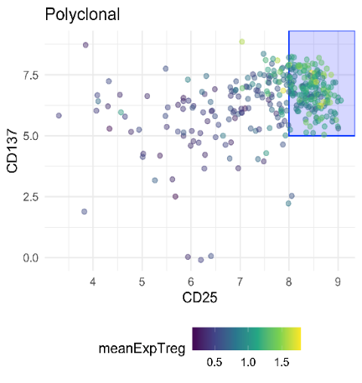
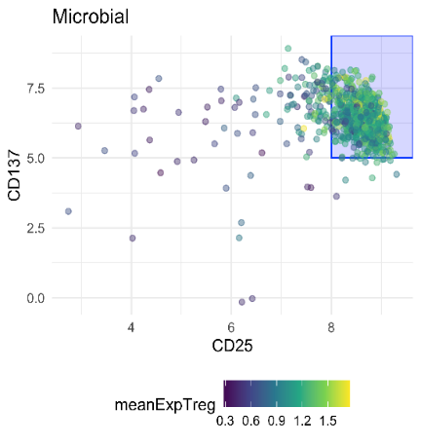
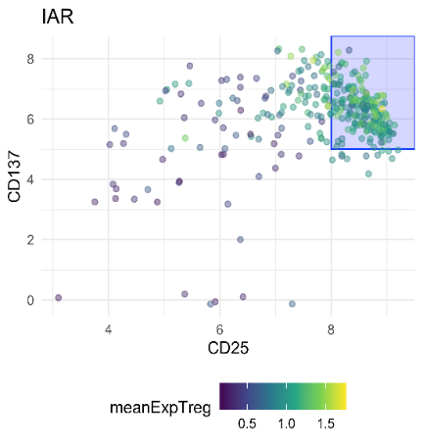
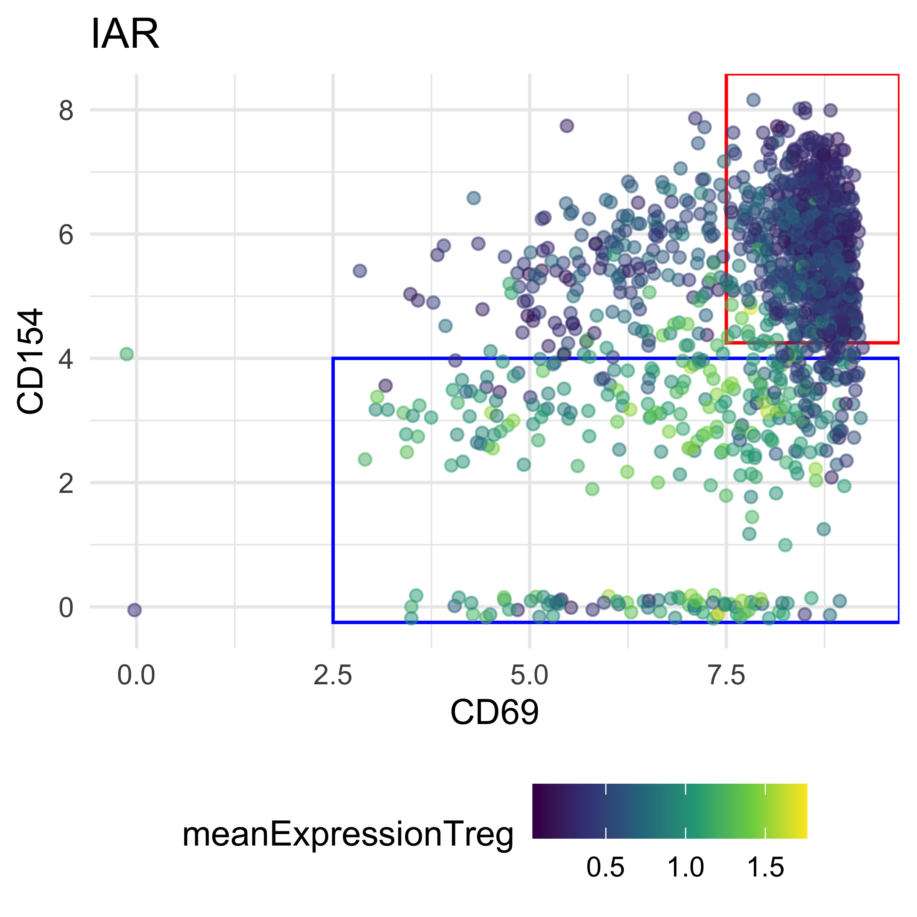
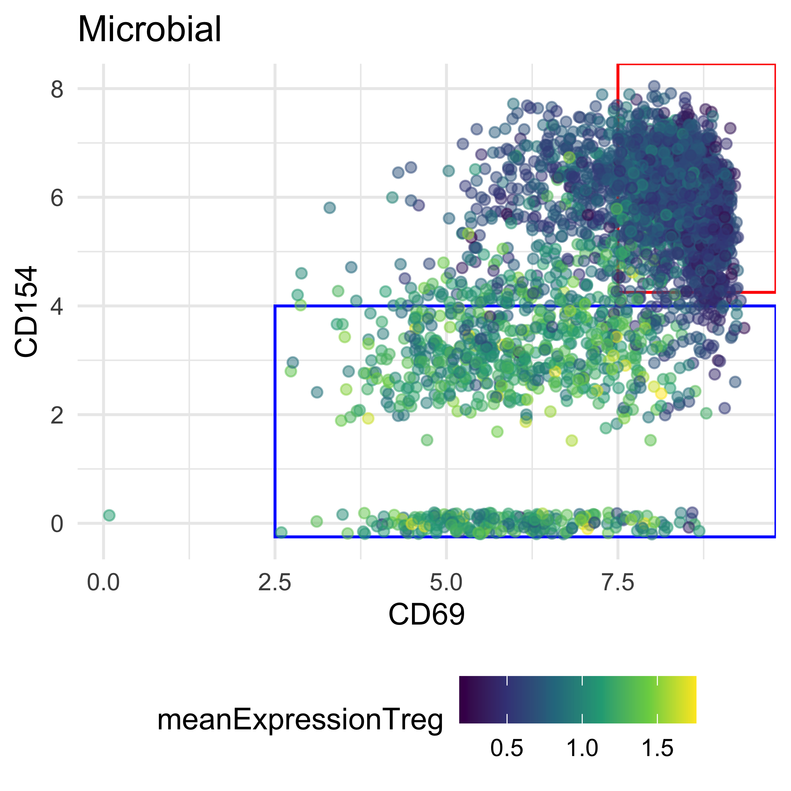
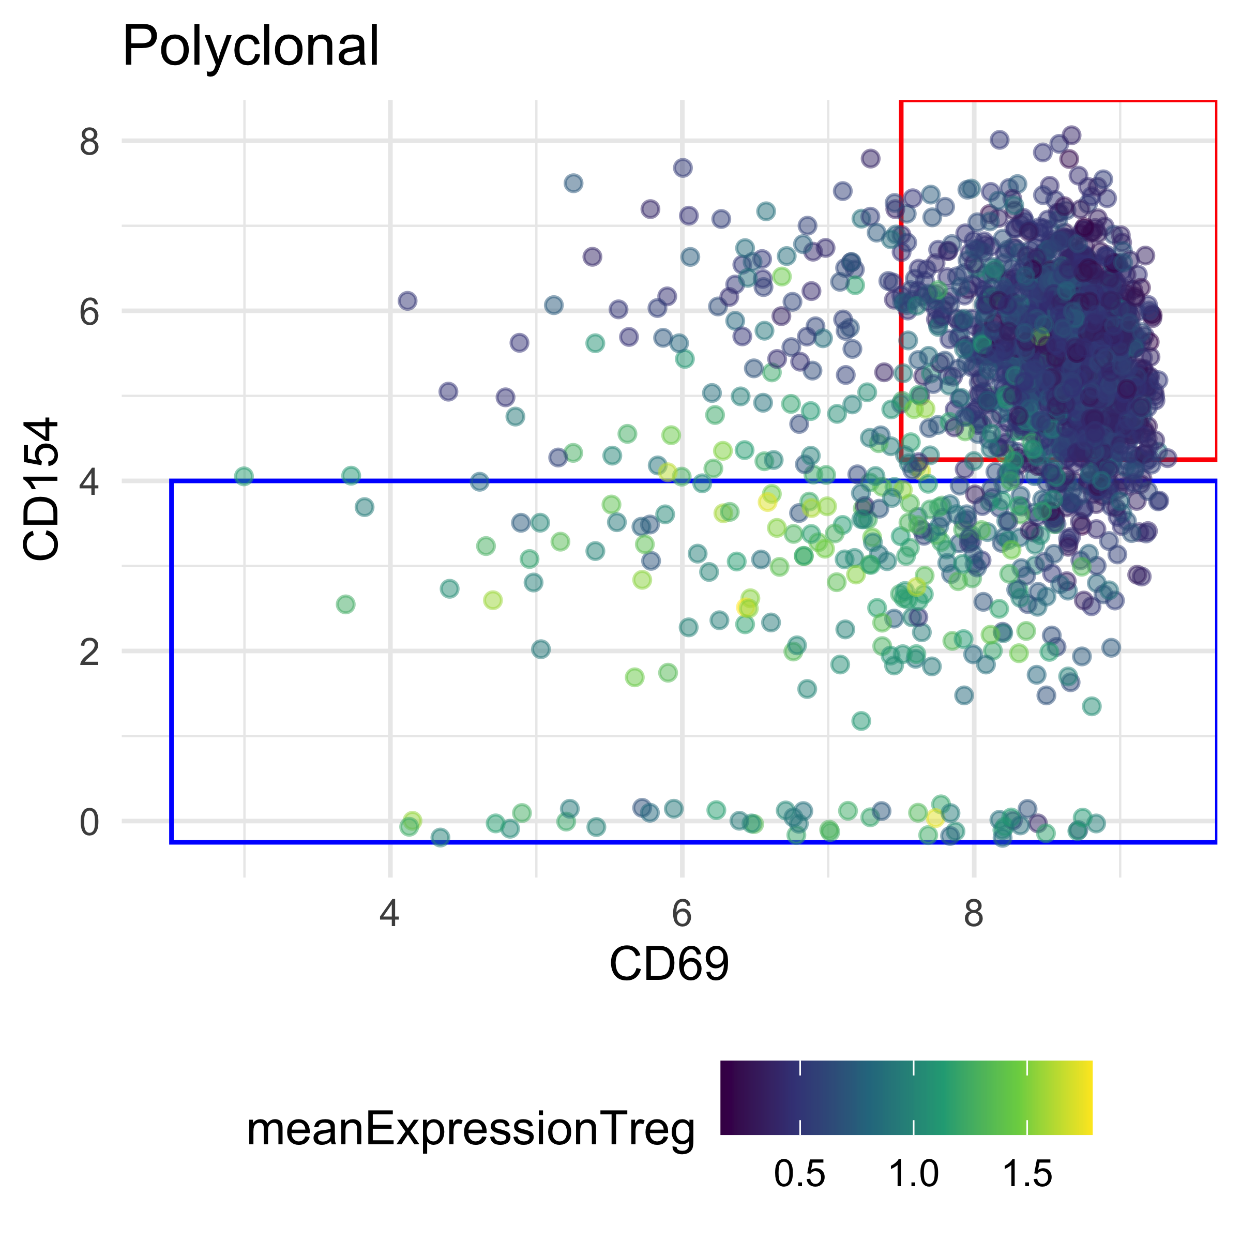
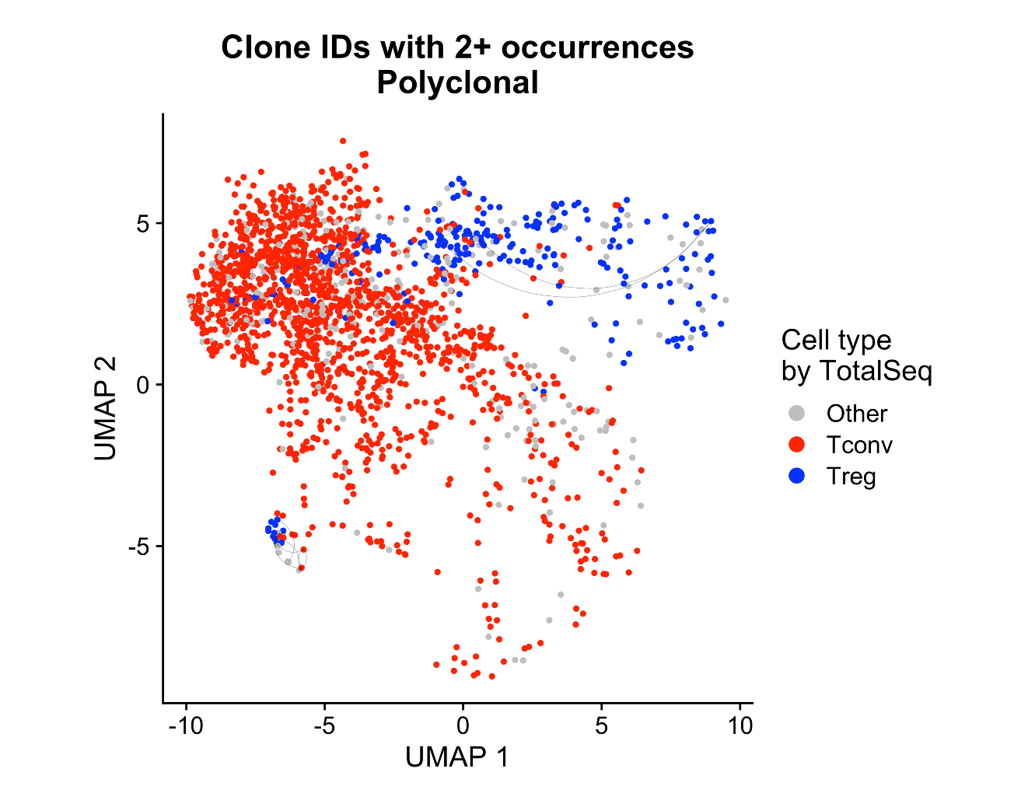
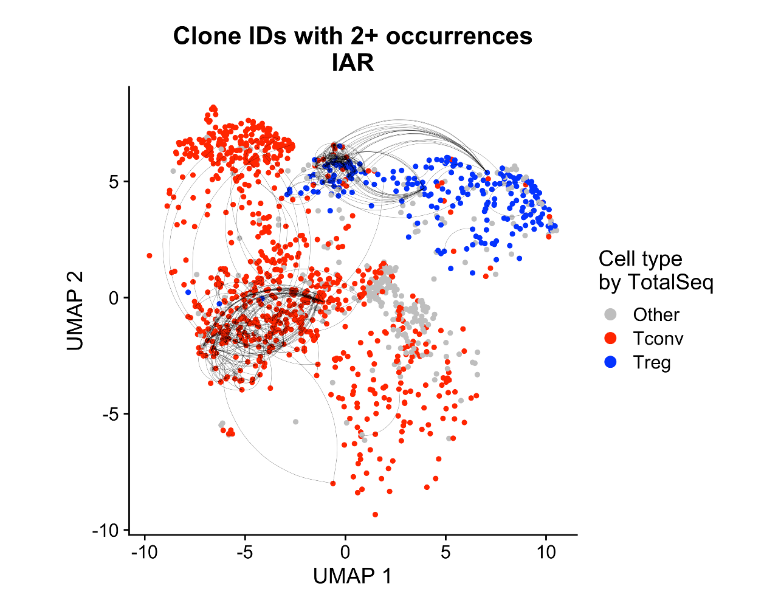
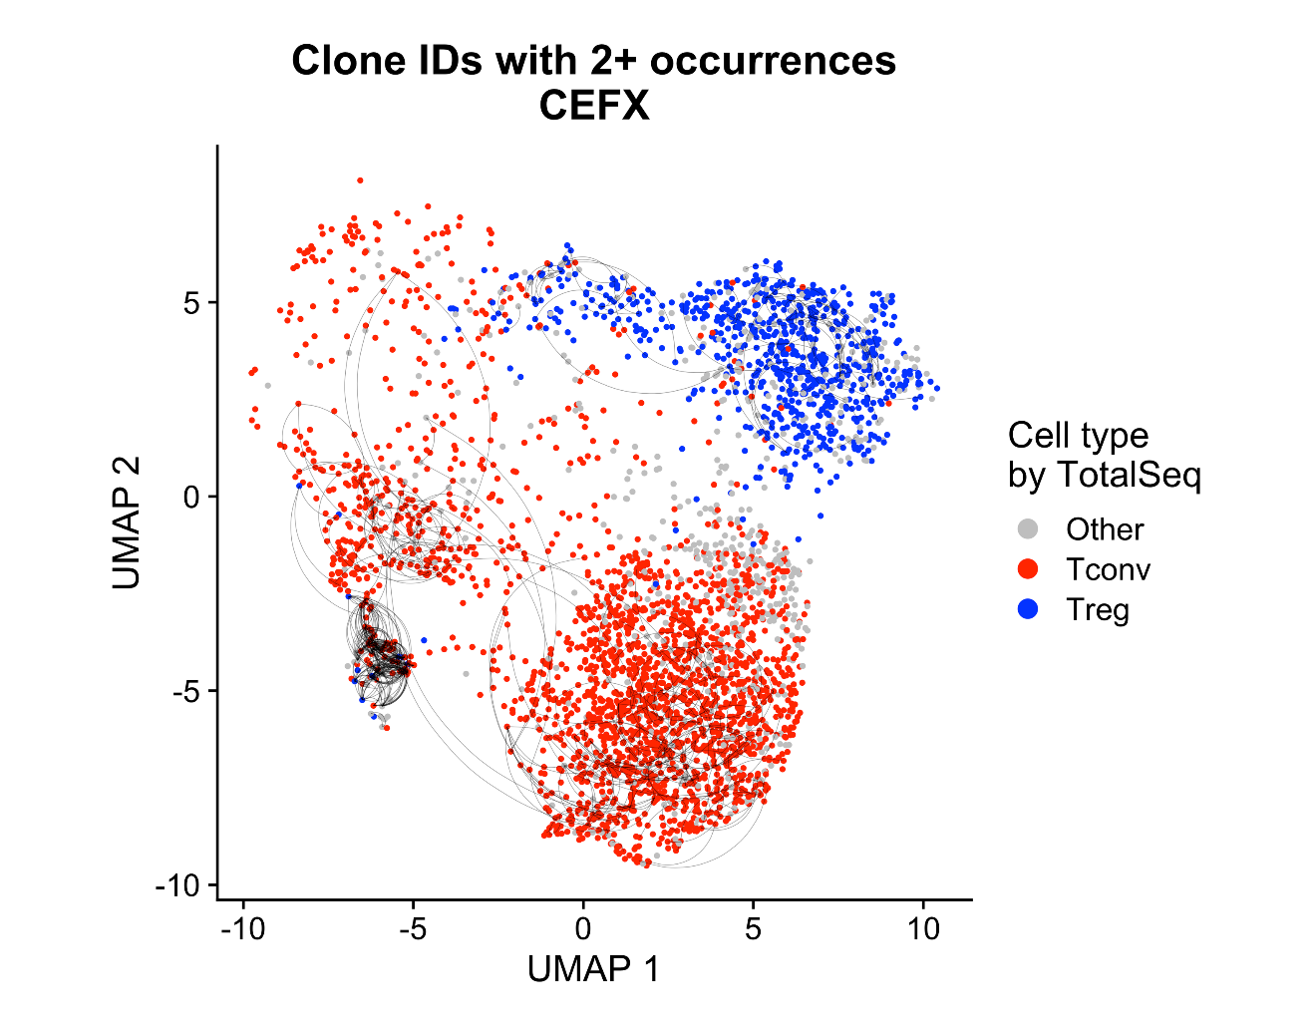
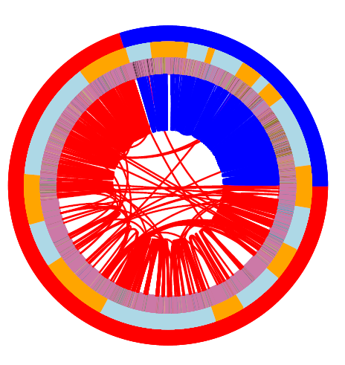
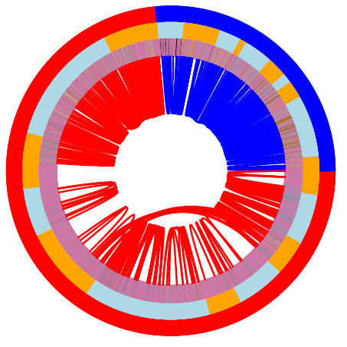
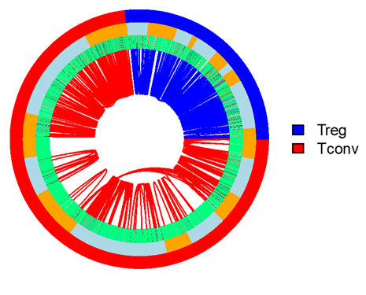
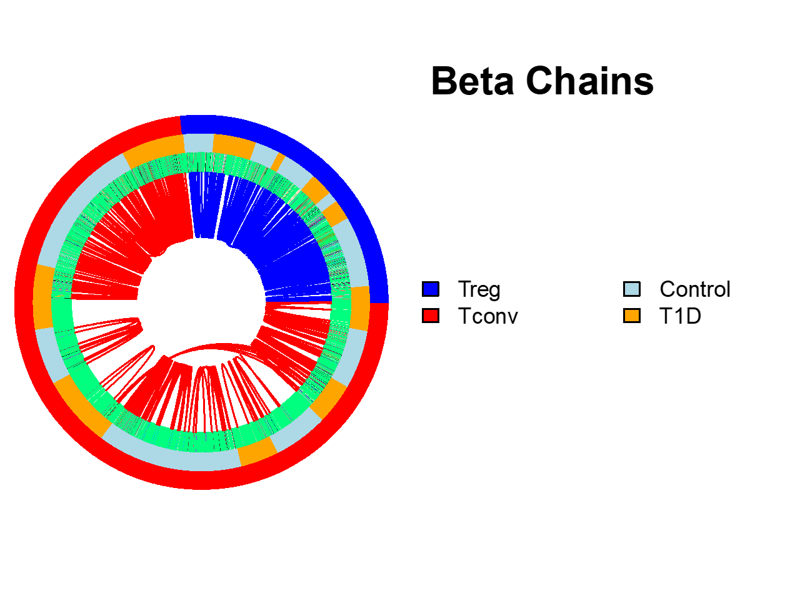

Foreign and autoreactive cd4 conventional and regulatory t cells in t1d and healthy subjects
Thomas H. Edwards^{2*}, Janice Chen^{1*}, Alex Hu², Vivian Gersuk², David J. Rawlings³, Jane Buckner¹, Karen Cerosaletti¹
Centers for ¹Translational and ²Systems Immunology, Benaroya Research Institute, Seattle WA;
³Seattle Children Research Institute; *Co-1st authors
Summary
Objective:
Characterize the features of islet autoreactive CD4 regulatory T cells (Tregs) in type 1 diabetes (T1D) compared to islet CD4 conventional T cells (Tconv) in the context of foreign antigen-reactive T cells
Approach:
Peripheral whole blood from cross sectional cohorts of established T1D subjects and matched non-diabetic healthy controls carrying the high-risk class II DRB1*0401 allele.
Isolated islet and foreign reactive CD4 Treg and Tconv cells using a CD154-CD137 activation induced marker (AIM) assay by single cell sorting followed by single cell RNA-sequencing utilizing 10X Chromium 5’ GEX/TCR/FB with Illumina P4 XLEAP.
Analyzed the transcriptomic and TCR profiles of foreign and islet reactive CD4 Tregs and Tconv cells in T1D donors compared with control donors.
Results:
Multiple samples can be prepared in one day, hashtagged, and combined
10X cell capture was poor, 35%, but chip was loaded on high end (50K)
We were able to test multiple stimulations
Polyclonal stimulated CD4 works well as a landscape of all CD4 T cells as they co-cluster with AIM stimulated cells
Ag specific but not polyclonal stimulated T cells show clonal expansion
Little TCR sharing between Tconv and Treg cells
Conclusion:
Islet autoreactive CD4 Tregs are less frequent than islet Tconv cells in T1D donors and are expanded consistent with antigen experience in vivo.
A. Study donors
Approach
Group | No. subjects | M:F | Age (median, range) | Disease duration (median, range) | HLA class II
T1D | 3 | x : x | xx y (xx-xx) | xx y (xx-xx) | DRB1*0401
Control | 3 | x : x | xx y (xx-xx) | -- | DRB1*0401
Fix bullet formatting. Edit/condense
B. Single cell sequencing pipeline
1. New sequencing technology successfully applied to AIM assay ?
Cell viability: 91% (REMOVE)
Lower than ideal
37,420 cells recovered/ 106K loaded – between 2 batches (35%)
overloaded – target should be 20-30K per lane (capture ~20K from 10X) (REMOVE TARGET INFO)
2,310 median genes/cell
24,244 total genes detected
8,117 Median UMI counts/cell
Remake these figures so that they fit in Shift the qc numbers to figures
Add cell capture table here
 | IAR | Microbial | Polyclonal
1_Control | 112 | 1422 | 42
2_T1D | 153 | 1869 | 160
3_Control | 238 | 3085 | 493
4_Control | 386 | 1327 | 602
5_T1D | 240 | 8342 | 275
6_T1D | 244 | 12384 | 436
C. Single cell analysis scheme
Ppt arrow flowchart instead of cartoon
Hashtag demultiplexing
RNA clustering Cell type identification
FB ‘gating’
DGE
TCR accounting
?
1873 Multiplet GEMs and 108 Negative GEMs identified and removed.
2. Technical analysis considerations (REWORD)
How many cells of each specificity in each Ag-specific gate?
4. Identification of Tregs and T conventional antigen-specific cells
Make this a flow chart
Make a stepwise/flowchart setup 1. Treg/Tconv 2. Ag-specific cells OR consider splitting 2 into another section
1. Microbial cells downsampled to 600 per donor
3. Optimize 2D UMAP embedding of PCA data with scDEED.
citation
Regenerate w new UMAP
Replace with alex’s P390 heatmap
Come up with a coherent way to unify these data to ID cells
Celltypist explanation + citation Consider removing
2. Optimize RNA clustering in PCA space with consensus of unsupervised clustering metrics.
Update UMAP
Condense/simplify
Make stimulation-facet ordering uniform
Create cartoon to explain – map projection example?
Add rest of gating figs
Show the example of removing suspicious cells improving the clustering (cluster 4 was split and then coalesced)
5. Both islet- and CEFX-specific Tregs/Tconvs are expanded, but share few TCR sequences
We reproduce prior IAR findings
FAR cells appear similar to IAR (remove IAR/FAR acronym)
Update celltype identification
CEFX
CD3/28
Islet
Make stimulation-facet ordering uniform
3. RNAseq Results
Most clusters have all donors and both studygroups
Cluster 0 almost entirely CEFX (FAR)
Most clusters contain cells of all specificities except 0, which is almost all CEFX. OR Islet T cells present in every cluster, however cluster 0 is almost all CEFX
Polyclonal Ab creates a suitable background landscape
There is some separation of foreign and IAR cells
Make p589-1 circos
Maybe do not need circos from P390 if no p589-1 circos
Consider separating out to have different conclusions
Islet autoreactive Tconv and Tregs are expanded within donors consistent with in vivo ag experience.
Tconv and Treg share TRA chains between donors.
Few TCR chains are shared between Tconv and Tregs.
TRA chains
TRB chains
Consider: all stim UMAP in box above, then split by stim in this section
Overlay the cluster numbers on the map
Circos plots depict TCR chain sharing from all Treg and Tconv cells. The outer ring shows cell type, the middle ring represents group, and the inner ring is colored by TCR sequence. Lines connect individual cells sharing TCR chains. Sharing was defined as identical nucleotide sequence of TRA and TRB chains.
Box to indicate donor effect
Deal with boundary box under logo
Acknowledgements:
BRI Center for Interventional Immunology
BRI Genomics Core Laboratory
Center for Systems Immunology
Kim Varner | Heather White | Jodie Stroud | David Lee | Kassidy Benoscek Sandra Lord MD | Cate Speake PhD
Kimberly O’Brien | Quynh-Anh Nguyen Jeffry Yaplee | Vivian Gersuk PhD
Update BRI names, add SCRI

Slide 2
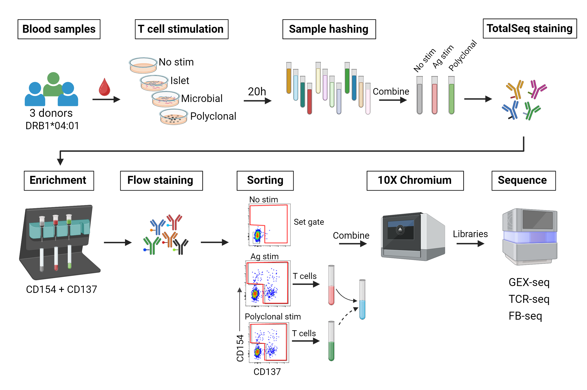
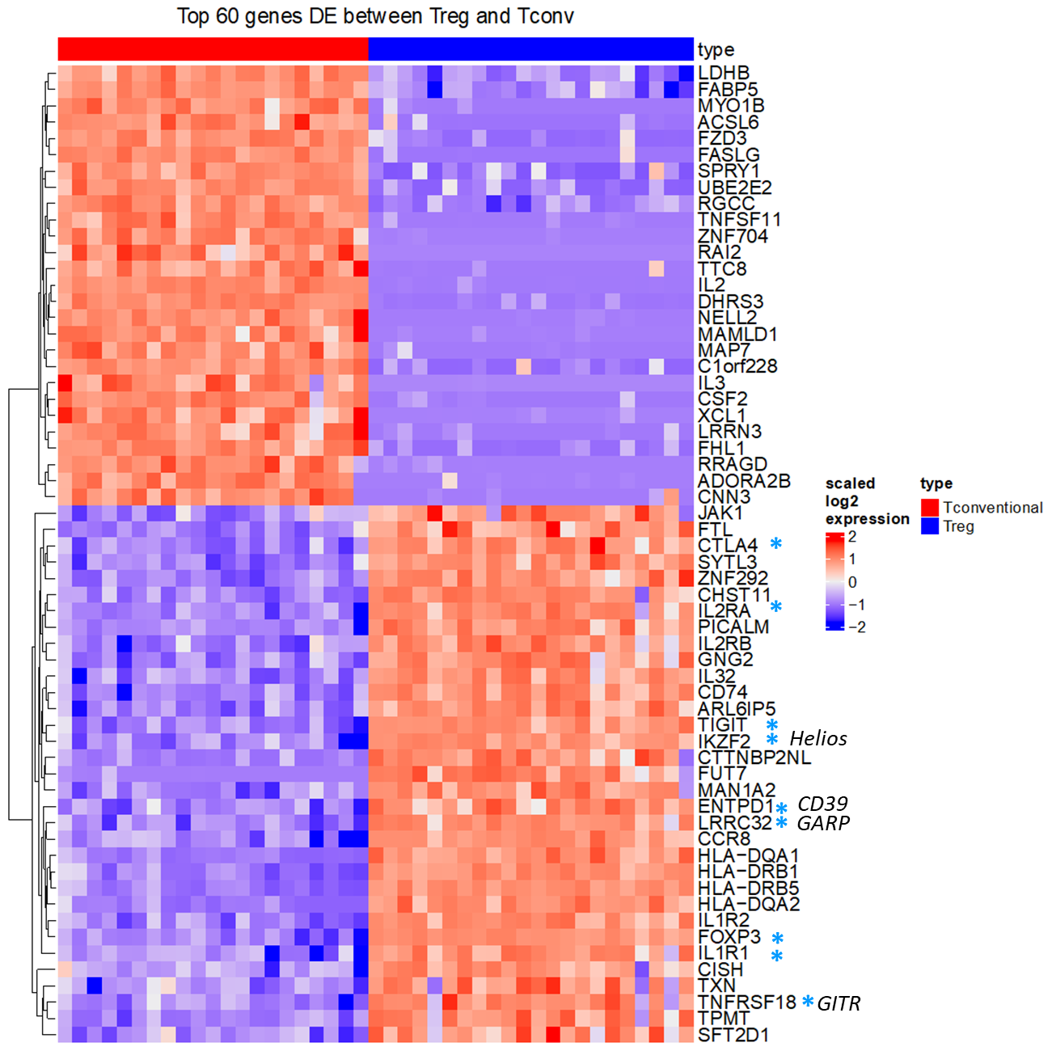
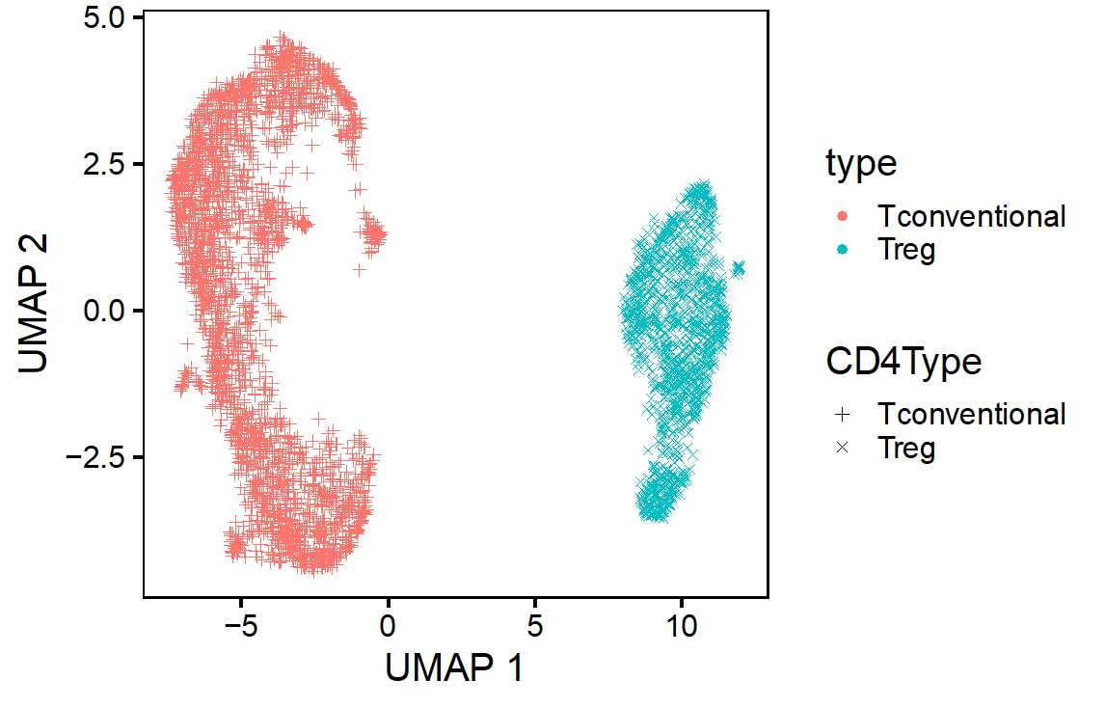
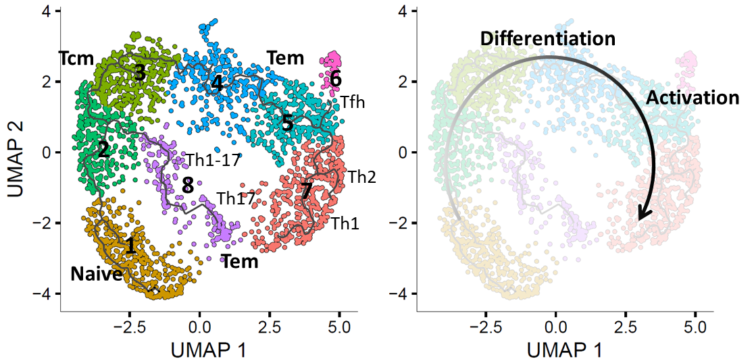
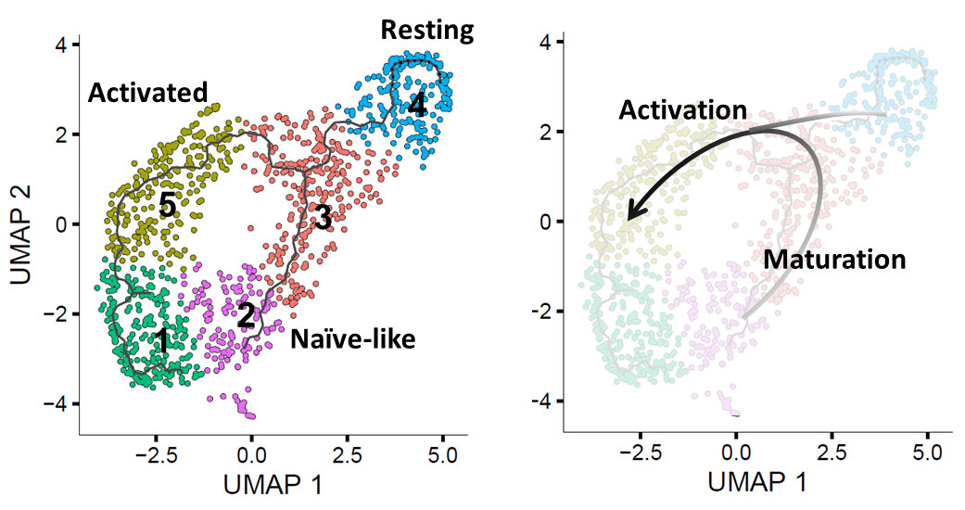
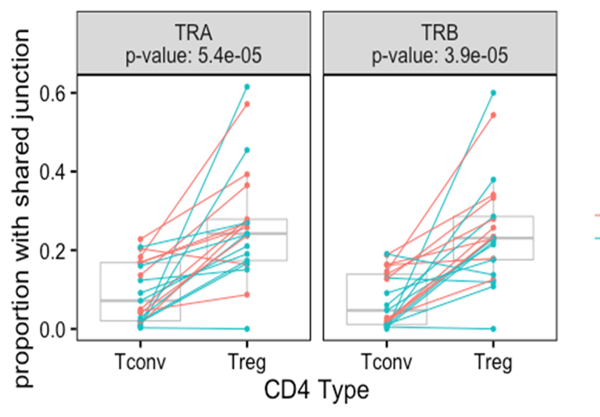
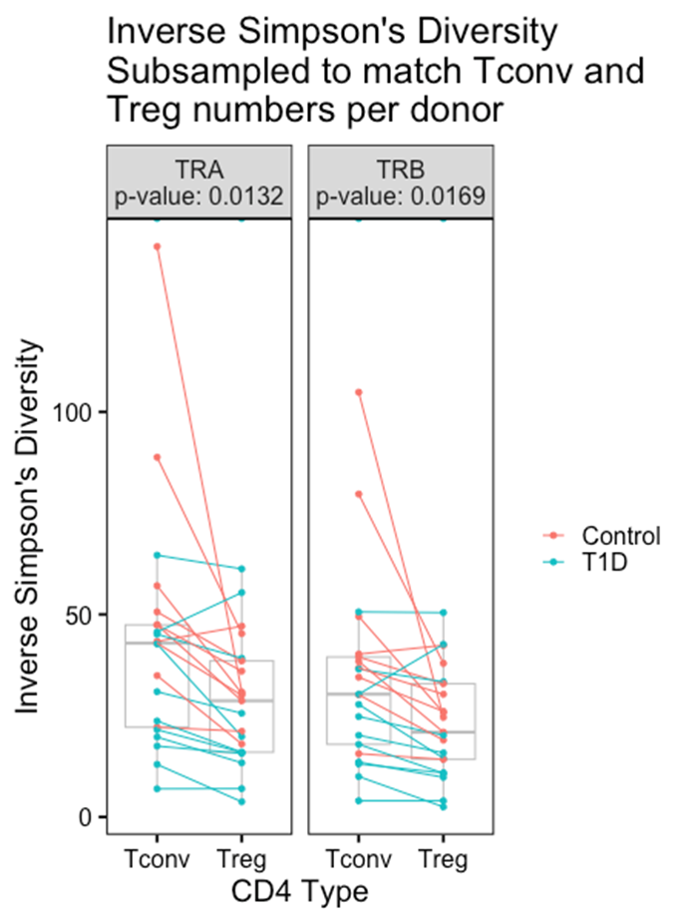
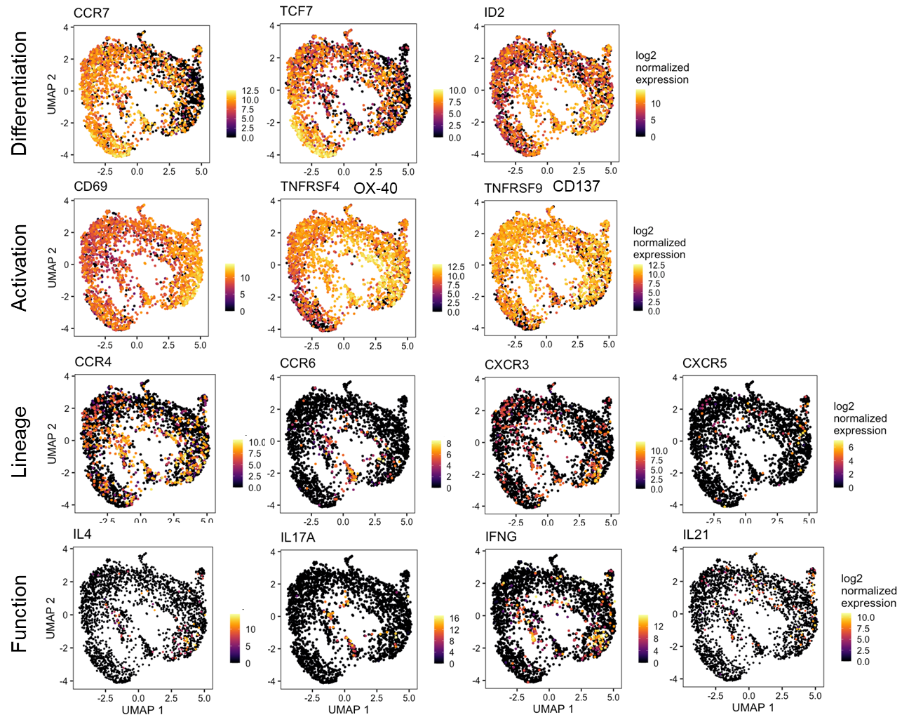
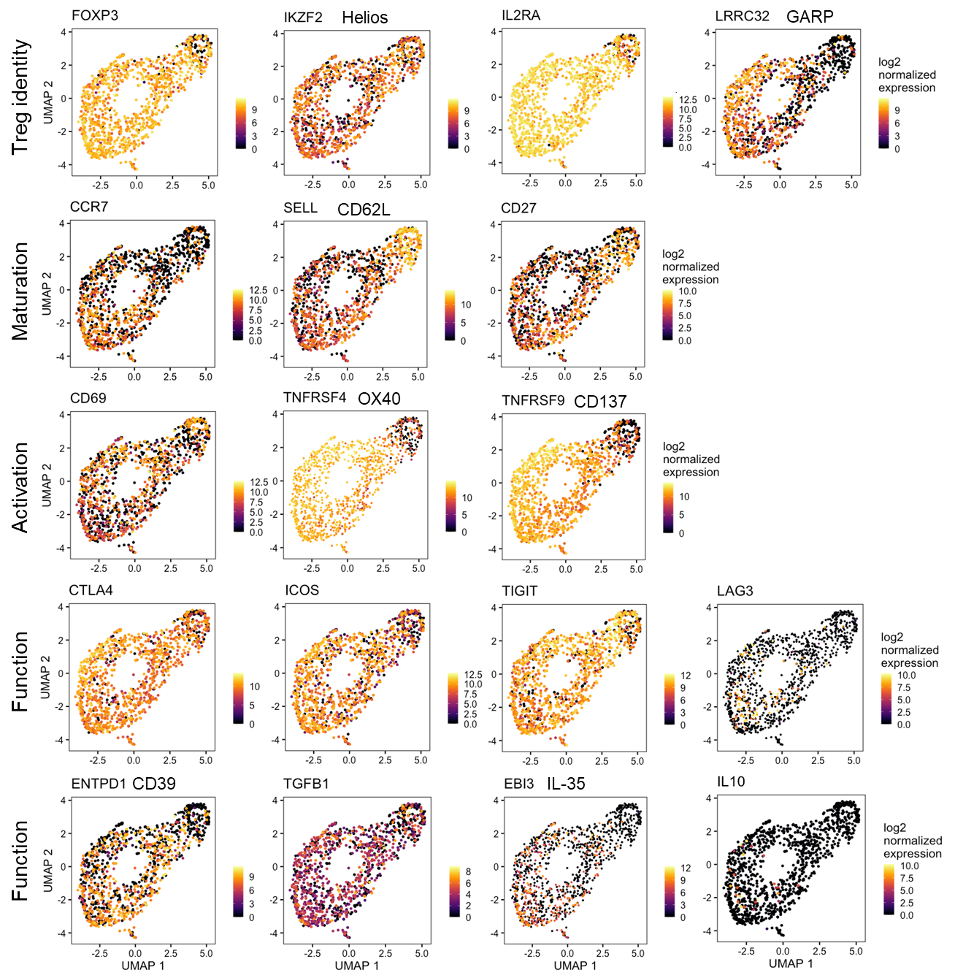
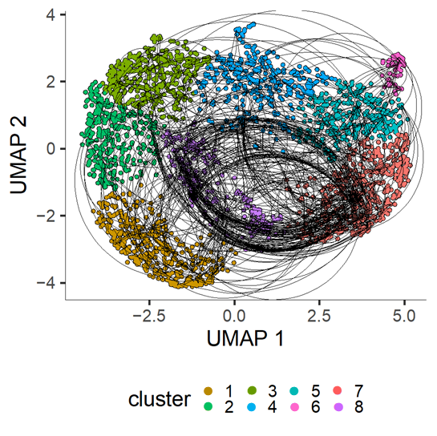
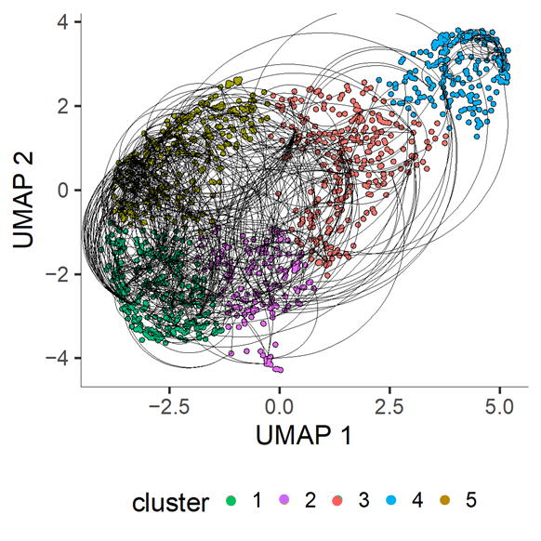
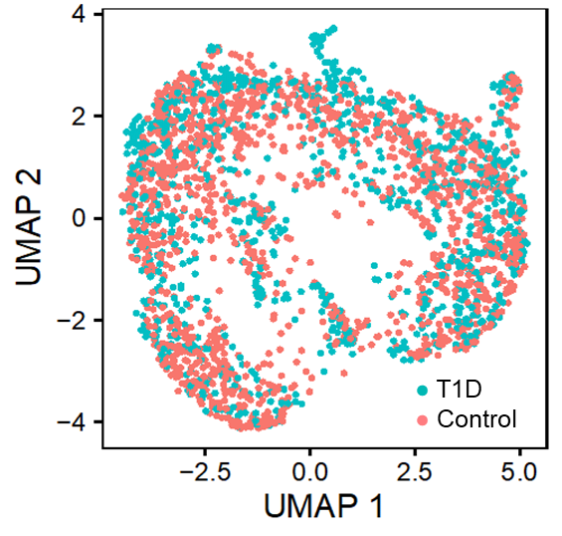
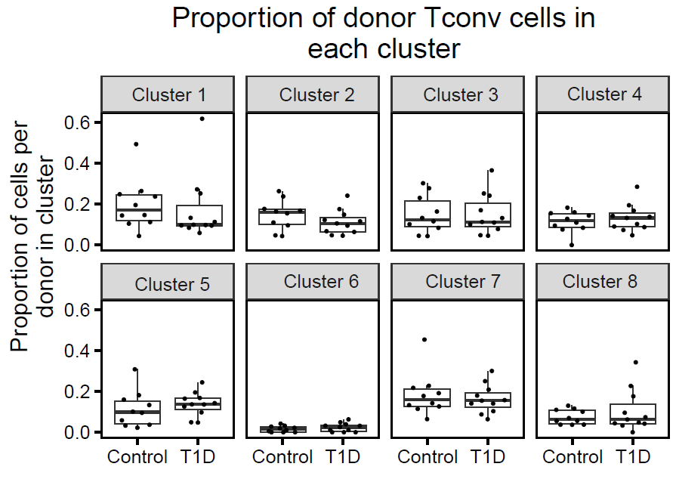
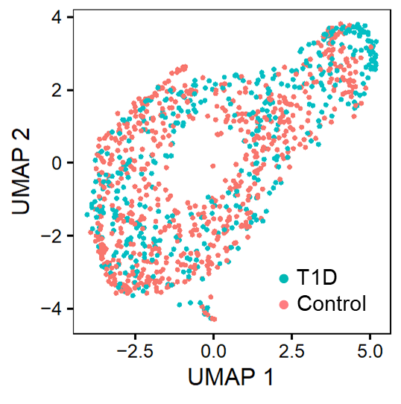
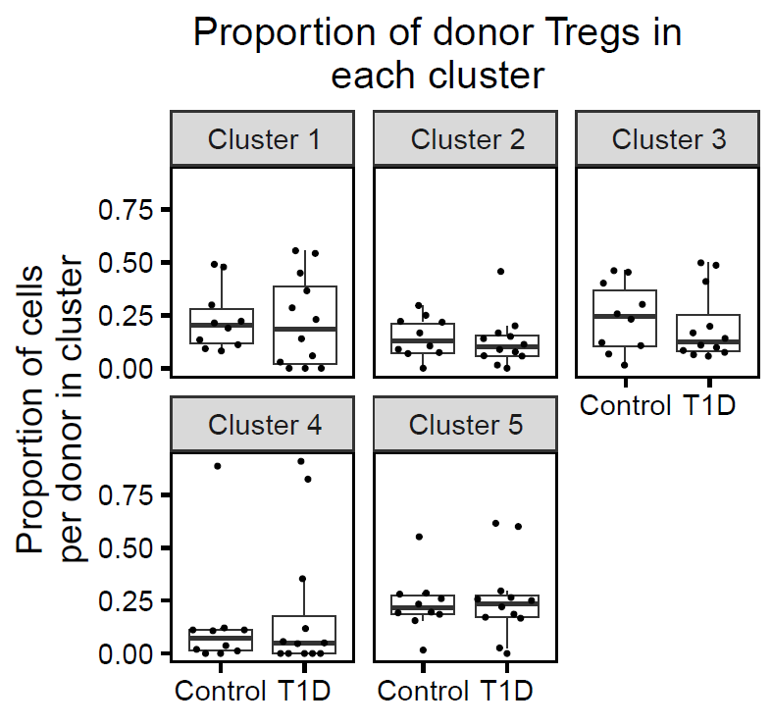
Foreign and autoreactive cd4 conventional and regulatory t cells in t1d and healthy subjects
Thomas H. Edwards^{2*}, Janice Chen^{1*}, Vivian Gersuk², David J. Rawlings³, Jane Buckner¹, Karen Cerosaletti¹
Centers for ¹Translational and ²Systems Immunology, Benaroya Research Institute, Seattle WA;
³Seattle Children Research Institute; *Co-1st authors
Summary
Objective:
Characterize the features of islet autoreactive CD4 regulatory T cells (Tregs) in type 1 diabetes (T1D) compared to islet CD4 conventional T cells (Tconv) in the context of foreign antigen-reactive T cells
Approach:
Peripheral whole blood from cross sectional cohorts of established T1D subjects and matched non-diabetic healthy controls carrying the high-risk class II DRB1*0401 allele.
Isolated islet and foreign reactive CD4 Treg and Tconv cells using a CD154-CD137 activation induced marker (AIM) assay by single cell sorting followed by single cell RNA-sequencing utilizing 10X Chromium 5’ GEX/TCR/FB with Illumina P4 XLEAP.
Analyzed the transcriptomic and TCR profiles of foreign and islet reactive CD4 Tregs and Tconv cells in T1D donors compared with control donors.
Results:
The frequency of islet autoreactive CD4 Tconv and Treg cells did not differ between T1D and control donors, however, islet autoreactive CD4 Tconv cells were significantly more frequent than Treg cells in T1D donors but not control subjects.
Islet reactive CD4 Treg cells had a Treg gene expression profile that differed from Tconv cells, but no differences were detected in transcript profiles of islet reactive Treg or Tconv cells between T1D donors and control subjects.
Islet autoreactive CD4 Treg were expanded and shared TCRs between donors; Tregs had more expanded TCR junctions per donor than Tconv cells.
Conclusion:
Islet autoreactive CD4 Tregs are less frequent than islet Tconv cells in T1D donors and are expanded consistent with antigen experience in vivo.
A. Study donors
Approach
Group | No. subjects | M:F | Age (median, range) | Disease duration (median, range) | HLA class II
T1D | 3 | x : x | xx y (xx-xx) | xx y (xx-xx) | DRB1*0401
Control | 3 | x : x | xx y (xx-xx) | -- | DRB1*0401
B. Single cell sequencing pipeline
1. Islet autoreactive CD4 Tconv cells are more frequent than Tregs in T1D
The frequency of islet autoreactive Tconv and Treg cells does not differ between healthy controls and T1D donors.
The frequency of islet autoreactive T conventional cells is significantly higher than regulatory T cells in T1D donors but not controls and not for foreign ag reactive T cells.
C. Single cell analysis scheme
RNA clustering Cell type identification
Hashtag demultiplexing
TCR accounting
FB ‘gating’
DGE
2. Islet autoreactive CD4 Treg cells are enriched for Treg signature genes
Differentially expressed genes between islet autoreactive CD4 Tregs cells vs. Tconv cells are enriched in Treg signature genes.
Single cell RNA-seq profiles for islet autoreactive Tregs cluster separately from Tconv cells in a UMAP projection.
4. Islet autoreactive CD4 Treg are expanded and share TCRs between donors
Circos plots showing expansion of islet reactive Tconv and Treg cells within donors and sharing of TCR chains between donors.
Islet autoreactive Tconv and Tregs are expanded within donors consistent with in vivo ag experience.
Tconv and Treg share TRA chains between donors.
Few TCR chains are shared between Tconv and Tregs.
TRA chains
TRB chains
Number of islet auto-reactive T cells by group.
Group | #Tconv | #Treg
T1D | 1,055 | 434
Control | 1,513 | 668
126 of 3796 cells were removed because they misclustered based on flow sorting cell type or because they had an iNKT or MAIT TCR.
3. Islet autoreactive CD4 Tconv and Treg cells do not differ transcriptionally between T1D and control donors
Circos plots depict TCR chain sharing from all Treg and Tconv cells. The outer ring shows cell type, the middle ring represents group, and the inner ring is colored by TCR sequence. Lines connect individual cells sharing TCR chains. Sharing was defined as identical nucleotide sequence of TRA and TRB chains.
Monocle 3 pseudotime trajectories of islet autoreactive CD4 Tconv and Treg cells. The trajectories are annotated based on marker gene expression.
Tregs have more expanded TCR junctions per donor than Tconv cells but there is no significant difference in expansion between T1D vs control donors for either cell type.
Islet Tconv cells
Islet Treg cells
Proportion of expanded CDR3 aa sequences per donor by cell type
Diversity of CDR3 aa sequences per donor
TRA
TRB
150
p-value: 0.0132
p-value: 0.0169
● T1D
● Control
100
● T1D
● Control
Inverse Simpson’s
diversity
50
0
Tconv
Treg
CD4 Type
Tconv
Treg
Analysis was performed by down sampling to equivalent numbers of Tconv and Treg cells. Down sampling was performed 100 times to assess significance.
5. TCR chains are shared between islet autoreactive Tconv and Treg cells with different phenotypes
Monocle 3 pseudotime trajectories are shown for islet reactive Tconv (left) and Treg cells (right). Cells sharing TCR chains (full nucleotide sequence) are connected by lines
Tconv
Treg
The distribution of control and T1D islet autoreactive Tconv and Treg cells doesn’t differ by cluster and no significant differentially expressed genes were identified between groups for either cell type.
Islet Tconv cells
Islet Treg cells
Acknowledgements:
BRI Center for Interventional Immunology
BRI Genomics Core Laboratory
Center for Systems Immunology
Kim Varner | Heather White | Jodie Stroud | David Lee | Kassidy Benoscek Sandra Lord MD | Cate Speake PhD
Kimberly O’Brien | Quynh-Anh Nguyen Jeffry Yaplee | Vivian Gersuk PhD

